Slide 1

Object Oriented Programming with C++ Day 1
Compiled by
M S Anand
Department of Computer Science

Slide 2

OOP with C++
Introduction
Text Book(s):
“C++ Primer”, Stanley Lippman, Josee Lajoie, Barbara E Moo, Addison-Wesley Professional, 5th Edition..
26/06/2023

Slide 3
OOP with C++
Syllabus and Evaluation guidelines
Syllabus is here.
Evaluation Policy: Quiz: 2 X 15 = 20
Project Demo: 20
26/06/2023

Slide 4
OOP with C++
Introduction
Desirable Knowledge: – Programming in C
26/06/2023

Slide 5
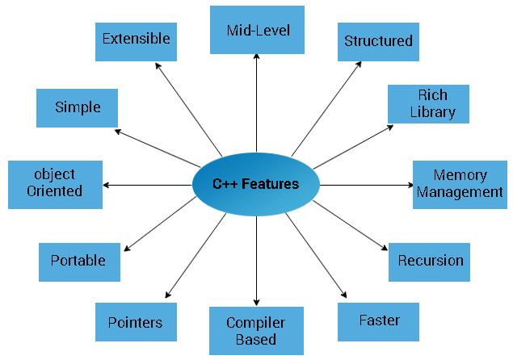
OOP with C++
Introduction ..
26/06/2023

Slide 6
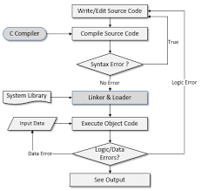
OOP with C++
An overview of C
Editing, Compiling, Linking and Executing a C program
26/06/2023

Slide 7
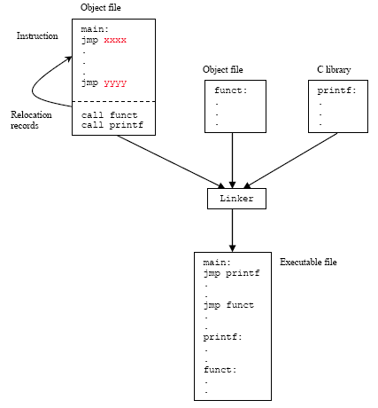
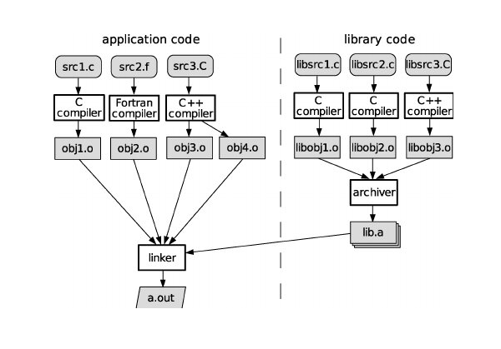
OOP with C++
An overview of C
Process of Linking and Loading
26/06/2023

Slide 8
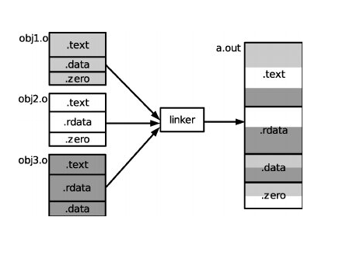
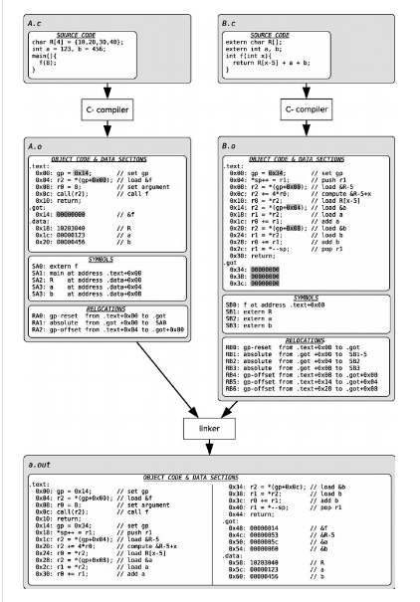

Slide 9
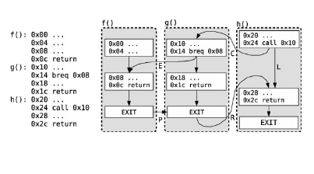

Slide 10
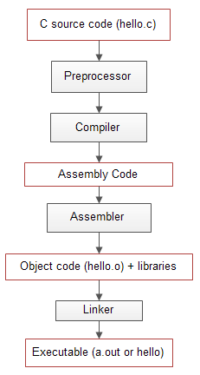
OOP with C++
An overview of C
26/06/2023

Slide 11
OOP with C++
An overview of C
.
Primitive data types
char
short
integer
long
float
double
26/06/2023

Slide 12
OOP with C++
An overview of C – Data types and range of values
.
Variable type | Keyword | Bytes required | Range
Character | char | 1 | -128 to 127
Unsigned character | unsigned char | 1 | 0 to 255
Integer | int | 2 (?) | -32768 to 32767
Short integer | short int | 2 | -32768 to 32767
Long integer | long int | 4 | -2,147,483,648 to 2,147,483,647
Unsigned integer | unsigned int | 2(?) | 0 to 65535
Unsigned short integer | unsigned short | 2 | 0 to 65535
Unsigned long integer | unsigned long | 4 | 0 to 4,294,967,295
Float | float | 4 | -3.4E+38 to +3.4E+38
Double | double | 8 | -1.7E+308 to +1.7E+308
Long long | long long | 8
Long double | long double | 10
Please predict the output of this program
Day1\d1p1.c
Please predict the output of this program
Day1\d1p2.c
26/06/2023

Slide 13
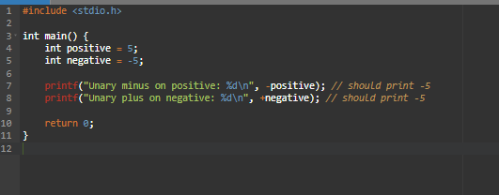
OOP with C++
An overview of C
.
Basic aritmetic operations:
Addition – ‘+’
Subtraction – ‘-’
Multiplication – ‘*’
Division – ‘/’
Modulo division – ‘%’
Unary minus operator
It produces a positive result when applied to a negative operand and a negative result when the operand is positive.
26/06/2023

Slide 14

OOP with C++
An overview of C
.
Assignment operators:
= Example: sum = 10
+= sum += 10; (Same as sum = sum + 10)
-= sum -= 10;
*= sum *= 10;
/= sum /= 10;
%= sum %= 10;
……………………
Which is more expensive
26/06/2023

Slide 15
OOP with C++
An overview of C
.
Relational operators:
> x > y
< x < y
>= x >= y
<= x <= y
!= x != y
== x == y
26/06/2023

Slide 16
OOP with C++
An overview of C
.
Increment and decrement operators:
Pre and post increment
Pre and post decrement
variable ++
++ variable
variable –
--variable
Please state the output of this program
Day1\d1p3.c
26/06/2023

Slide 17
OOP with C++
An overview of C
.
Logical operators:
&& - Logical AND True only if all operands are true
|| - Logical OR True if any of the operands is true.
! – Logical NOT True if the operand is zero.
26/06/2023

Slide 18
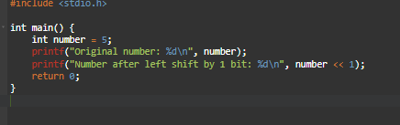
OOP with C++
An overview of C
.
Bitwise operators:
& - Bitwise AND
| - Bitwise OR
^ – Bitwise exclusive OR
~ - Bitwise complement
<< - Shift left
>> - Shift right
Other operators
Comma operators are used to link related expressions together. For example:
int a, c = 5, d;
sizeof operator
26/06/2023

Slide 19
What do you think is the output of these programs
Day1\d1p4.c
Day1\d1p5.c

Slide 20
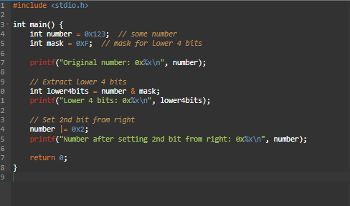

Slide 21
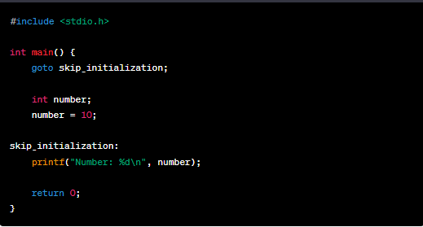
OOP with C++
An overview of C
.
Decision making
if, else, else if
switch case
The ternary operator
condition ? expression1 : expression2
x = y > 7 ? 25 : 50;
The goto statement
goto label;
label:
26/06/2023

Slide 22
Sometimes Goto are good
For example if you wish to exit out of a deep loop
Or you would want to do error handling
Day1\d7.c
Day1\d1p8.c

Slide 23
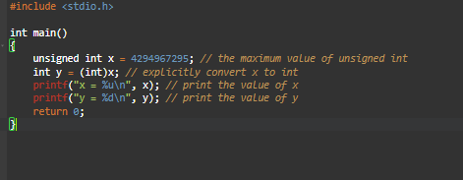
OOP with C++
An overview of C
.
Type conversions
Explicit – You do it yourself in the program
Implicit – The compiler does it for you
Enumerations
enum Weekday {Monday, Tuesday, Wednesday, Thursday, Friday, Saturday, Sunday};
enum Weekday today = Wednesday;
How to set this program right see Day1\d1p9.c
Day1\d1p10.c
26/06/2023

Slide 24
OOP with C++
An overview of C
.
Operator precedence and associativity
The C operator precedence table is here.
The loops:
The “for” loop
The “while” loop
The “do … while” loop
The break statement
The continue statement
26/06/2023

Slide 25
OOP with C++
An overview of C
.
Arrays
Index starts from 0
Single, Multi-dimensional arrays
Row major or Column major ?
A string in C is a character array terminated with ‘\0’
Day1\d1t11.txt
Can you look at the following programs and tell me which is better ( R or C major and explain why?
Day1\d1p12.c
Day1\d1p13.c
26/06/2023

Slide 26
OOP with C++
An overview of C
.
The nine most commonly used functions in the string library are:
strcat - concatenate two strings
strchr - string scanning operation
strcmp - compare two strings
strcpy - copy a string
strlen - get string length
strncat - concatenate one string with part of another
strncmp - compare parts of two strings
strncpy - copy part of a string
strrchr - a pointer to the last occurrence of c within s instead of the first.
Day1\d1p14.c Can you state would you prefer arrays or pointers for this program
26/06/2023

Slide 27
Reasons for using pointers are
For strcpy, it is better to use pointers than arrays in C, because pointers are more flexible and efficient than arrays. Some reasons are:
Pointers can point to any memory location, while arrays are fixed in size and location. This means that pointers can be used to copy strings of different lengths and from different sources, while arrays may not have enough space or may not be accessible.
Pointers can be passed by value to functions, while arrays are passed by reference. This means that pointers can be modified inside functions without affecting the original strings, while arrays cannot. This can prevent unwanted side effects and improve readability and maintainability of the code.
Pointers can be incremented or decremented to access different elements of a string, while arrays need to use subscript notation. This means that pointers can be used to copy strings in a single loop, while arrays may need nested loops. This can improve performance and reduce complexity of the code.

Slide 28
OOP with C++
An overview of C
.
Using the sizeof operator with arrays
The sizeof operator executed on an array gives the size of the array in bytes:
char arr [20];
sizeof (arr) – results in 20 bytes
What about the following:
int iarr [20];
sizeof (iarr) - ??
long larr [40];
sizeof (larr) - ??
const char hex_array[] = {‘A’, ‘B’}; // Size ? 2 or 3
26/06/2023

Slide 29
OOP with C++
An overview of C
.
Pointers
The pointer in C language is a variable which stores the address of another variable. This variable can be of type int, char, array, function, or any other pointer including a null pointer.
Can we have pointers of type void
What is used for ? See thisDay1\d1p15.c
26/06/2023

Slide 30
OOP with C++
An overview of C
.
Arrays and Pointers – Differences
the sizeof operator
sizeof(array) returns the amount of memory used by all elements in array
sizeof(pointer) only returns the amount of memory used by the pointer variable itself.
the & operator
&array is an alias for &array[0] and returns the address of the first element in array
&pointer returns the address of pointer
a string literal initialization of a character array
char array[] = “abc” sets the first four elements in array to ‘a’, ‘b’, ‘c’, and ‘\0’
char *pointer = “abc” sets pointer to the address of the “abc” string (which may be stored in read-only memory and thus unchangeable)
Pointer variable can be assigned a value whereas array variable cannot be.
Arithmetic on pointer variable is allowed.
26/06/2023

Slide 31
OOP with C++
An overview of C
.
Pointers
Note
char* is a mutable pointer to a mutable character/string.
const char* is a mutable pointer to an immutable character/string. You cannot change the contents of the location(s) this pointer points to. Also, compilers are required to give error messages when you try to do so. For the same reason, conversion from const char * to char* is deprecated.
char* const is an immutable pointer (it cannot point to any other location) but the contents of location at which it points are mutable.
const char* const is an immutable pointer to an immutable character/string.
See Day1\d1p16.c
void *ptr;
26/06/2023

Slide 32
OOP with C++
An overview of C
.
Structure
A structure is a user defined data type in C.
A structure creates a data type that can be used to group items of possibly different types into a single type.
How to create a structure? ‘struct’ keyword is used to create a structure.
struct address
{
char name[50];
char street[100];
char city[50];
char state[20];
int pin;
};
26/06/2023

Slide 33
OOP with C++
An overview of C
.
Accessing structure members through the “.” Operator.
If you have a pointer to a structure, then use the -> operator.
sizeof a structure.
When to use . Operator and when to use -> operator in a structure
See Day1\d1p17.c
26/06/2023

Slide 34
OOP with C++
An overview of C
.
Dynamic memory allocation
void *malloc(int size);
void *calloc(int nmemb, int size); – Memory set to zero.
void *realloc(void *ptr, size_t size);
free(void *ptr);
Which is faster and why? Physically are calloc blocks contigious?
26/06/2023

Slide 35
OOP with C++
An overview of C
.
Linked lists
struct Node
{
int data;
struct Node *next;
};
struct Node
{
int data;
struct Node *next;
struct Node *prev;
};
26/06/2023

Slide 36
OOP with C++
An overview of C
.
File operations in C
FILE *fopen(const char *name, const char *mode);
fclose(FILE *)
size_t fread(void *ptr, size_t size, size_t nmemb, FILE *stream);
size_t fwrite(const void *ptr, size_t size, size_t nmemb, FILE *stream);
int fseek(FILE *stream, long offset, int whence);
long ftell(FILE *stream);
Lot more functions like fgetc(), fgets(), fputc(), fputs() …….
26/06/2023

Slide 37
OOP with C++
An overview of C
.
Bit fields
// A space optimized representation of date
struct date
{
// d has value between 1 and 31, so 5 bits are sufficient
unsigned int d: 5;
// m has value between 1 and 12, so 4 bits are sufficient
unsigned int m: 4;
unsigned int y;
};
Day1\d1p22.c
26/06/2023

Slide 38
OOP with C++
An overview of C
.
Unions
User defined data type just like a structure.
union sample
{
char name [4];
long length;
short s1;
};
26/06/2023

Slide 39
OOP with C++
An overview of C
.
#include <stdio.h>
int main (void)
{
union long_bytes
{
char ind [4];
long ll;
} u1;
long l1 = 0x10203040;
int i;
u1.ll = l1;
for (i = 0; i < sizeof (long); i ++)
printf ("Byte %d is %x\n", i, u1.ind [i]);
return 0;
}
26/06/2023

Slide 40
OOP with C++
An overview of C
.
Little Endian and Big Endian
C language uses 4 storage classes,
auto, extern, static and register.
auto
This is the default storage class for all the variables declared inside a function or a block. Hence, the keyword auto is rarely used while writing programs in C language.
extern:
Extern storage class simply tells us that the variable is defined elsewhere and not within the same block where it is used.
Static
Their scope is local to the function to which they were defined.
26/06/2023

Slide 41
Big Endian or Little Endian
+----+----+----+----+
|0x78|0x56|0x34|0x12| 0x12345678
+----+----+----+----+
+----+----+----+----+
|0x12|0x34|0x56|0x78|
+----+----+----+----+
Which is liitle Endian and which is big endian?
Write a program to find out if say int x = 1 , is big endian or little endian?

Slide 42
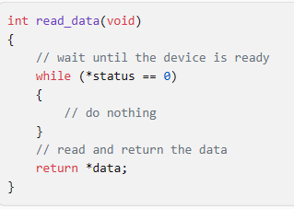
OOP with C++
An overview of C
.
register
This storage class declares register variables which have the same functionality as that of the auto variables. The only difference is that the compiler tries to store these variables in the register of the microprocessor if a free register is available.
volatile
C's volatile keyword is a qualifier that is applied to a variable when it is declared. It tells the compiler that the value of the variable may change at any time--without any action being taken by the code the compiler finds nearby. DON’T BE SILLY AND OPTIMIZE
26/06/2023

Slide 43
OOP with C++
An overview of C
.
Functions in C
Function declaration
Function call
Function definition
Pointers to functions
function_return_type(*Pointer_name)(function argument list)
For example:
double (*p2f)(double, char)
Day1\d1p24.c
26/06/2023

Slide 44
OOP with C++
An overview of C
.
Command line arguments
int main (int argc, char **argv)
{
}
argc ??
argv[0] - ??
How to pass an argument like “PES University”?
What does argc and argv contain?
Day1\d1p25.c
26/06/2023

Slide 45
OOP with C++
An overview of C
.
Environment variables
int main (int argc, char **argv, char **envp)
extern char **environ;
Functions with variable number of arguments
int func(int, ... )
{ . . .
}
Day1\va_args.c
int main()
{
func(1, 2, 3);
func(1, 2, 3, 4);
}
More on this later … we use varaidic templates in c++ which is far superior… so not covering this
26/06/2023

Slide 46
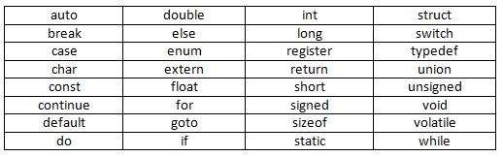
OOP with C++
Keywords in C
.
26/06/2023

Slide 47
OOP with C++
Introduction to C++
.
What is C++?
C++ is a cross-platform language that can be used to create high-performance applications.
C++ was developed by Bjarne Stroustrup, as an extension to ‘C’.
C++ gives programmers a high level of control over system resources and memory.
The language had 4 major updates in 2011, 2014, 2017, and 2020 to C++11, C++14, C++17, C++20. The most commonly used version is C++11 (we use this version in most of our programs)
26/06/2023

Slide 48
OOP with C++
C++ 11 – Additional features
.
C++ 11:
Unified Initialization
// uninitialized built-in type
int i;
// initialized built-in type
int j=10;
// initialized built-in type
int k(10);
// Aggregate initialization
int a[]={1, 2, 3, 4}
// default constructor
X x1;
// Parameterized constructor
X x2(1);
// Parameterized constructor with single argument
X x3=3;
26/06/2023

Slide 49
OOP with C++
C++ 11 – Additional features
.
Multithreading
Prior to C++11, we had to use POSIX threads or <pthreads> library. While this library did the job the lack of any standard language-provided feature set caused serious portability issues. C++ 11 did away with all that and gave us std::thread. The thread classes and related functions are defined in the <thread> header file.
Smart Pointers
A Smart Pointer is a wrapper class over a pointer with an operator like * and -> overloaded. The objects of the smart pointer class look like normal pointers. But, unlike Normal Pointers, object memory is deallocated when they go out of scope.
26/06/2023

Slide 50
OOP with C++
C++ 11 – Additional features
.
Hash Tables
C++11 has hash tables in four variations. The official name is unordered associative containers. Unofficially, they are called dictionaries or just simple associative arrays.
std::array container
std::array is a container for constant size arrays. It's a sequential container class defined in <array> that specifies a fixed length array at compile time.
Move semantics
In C++11, the resources of the objects can be moved from one object to another rather than copying the whole data of the object to another. This can be done by using move semantics in C++11. Move semantics points the other object to the already existing object in the memory.
26/06/2023

Slide 51
OOP with C++
C++ 11 – Additional features
.
Lambda functions included
function-like blocks of executable statements that you can insert where normally a function call would appear. Lambdas are more compact, efficient, and secure than function objects.
auto
C++11 introduces the keyword auto as a new type specifier. auto acts as a placeholder for a type to be deduced from the initializer expression of a variable. With auto type deduction enabled, you no longer need to specify a type while declaring a variable.
decltype
The decltype(expression) specifier is a type specifier introduced in C++11. With this type specifier, you can get a type that is based on the resultant type of a possibly type-dependent expression.
26/06/2023

Slide 52
OOP with C++
Introduction to C++
.
Why Use C++
C++ is one of the world's most popular programming languages. According to TIOBE index (June 2023), the 4 most popular programming languages are Python, C, C++ and Java, in that order.
C++ can be found in today's operating systems, Graphical User Interfaces, and embedded systems.
C++ is an object-oriented programming language which gives a clear structure to programs and allows code to be reused, lowering development costs.
C++ is portable and can be used to develop applications that can be adapted to multiple platforms.
C++ is fun and easy to learn!
As C++ is close to C# and Java, it makes it easy for programmers to switch to C++ or vice versa.
26/06/2023

Slide 53
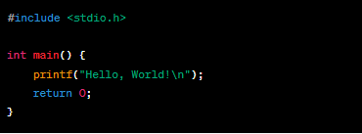
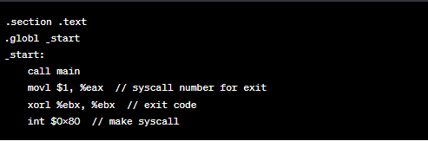
OOP with C++
An introduction to C++
.
We can use “g++” as the compiler from command line or
We can use any of the IDEs like CodeBlocks, Visual Studio, etc.
We will use g++ in this course.
The first C++ program.
first.cpp
Who calls main() ??
26/06/2023

Slide 54
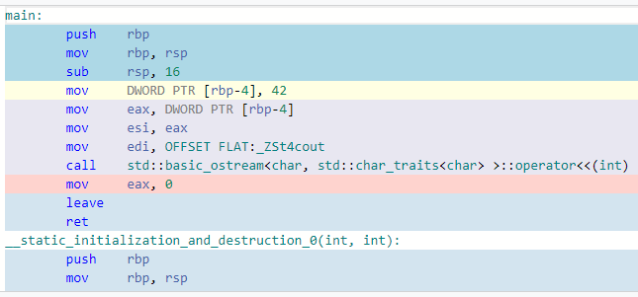
This gets fused with ctro _start at the top

Slide 55
OOP with C++
An introduction to C++
.
Standard I/O libraries
std::cout << "Enter two numbers:" << std::endl;
The << operator takes two operands:
The left-hand operand must be an ostream object; the right-hand operand is a value to print. The operator writes the given value on the given ostream.
The result of the output operator is its left-hand operand. That is, the result is the ostream on which we wrote the given value.
Our output statement uses the << operator twice. Because the operator returns its left-hand operand, the result of the first operator becomes the left-hand operand of the second.
As a result, we can chain together output requests.
26/06/2023

Slide 56
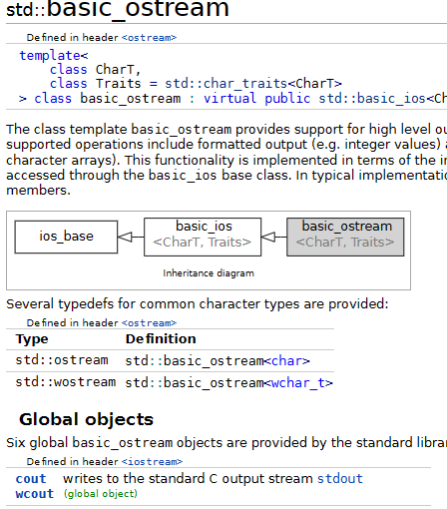
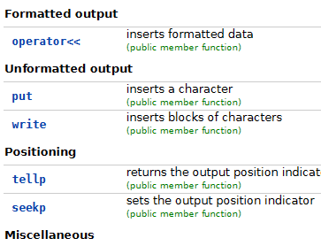

Slide 57
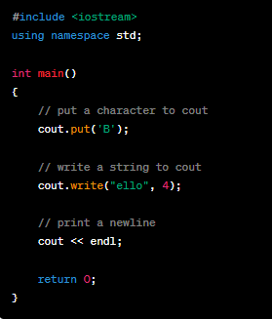
OOP with C++
An introduction to C++
.
What does endl achieve?
The second operator prints endl, which is a special value called a manipulator.
Writing endl has the effect of ending the current line and flushing the buffer associated with that device.
Flushing the buffer ensures that all the output the program has generated so far is actually written to the output stream, rather than sitting in memory waiting to be written
26/06/2023

Slide 58
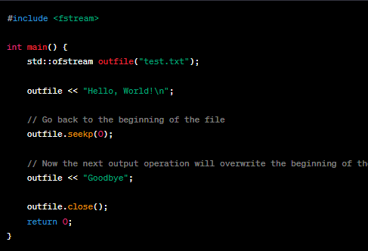

Slide 59
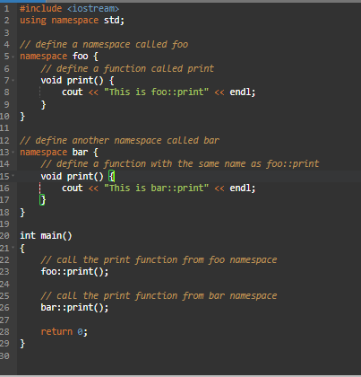
OOP with C++
An introduction to C++
.
Using names from standard library
This program uses std::cout and std::endl rather than just cout and endl.
The prefix std:: indicates that the names cout and endl are defined inside the namespace named std.
Namespaces allow us to avoid inadvertent collisions between the names we define and uses of those same names inside a library.
All the names defined by the standard library are in the std namespace.
26/06/2023

Slide 60
OOP with C++
An introduction to C++
.
Reading from a Stream Start by defining two variables named v1 and v2 to hold the input: int v1 = 0, v2 = 0; The statement std::cin >> v1 >> v2; reads the input.
The input operator (the » operator) behaves analogously to the output operator. It takes an istream as its left-hand operand and an object as its right-hand operand. It reads data from the given istream and stores what was read in the given object. Like the output operator, the input operator returns its left-hand operand as its result.
Hence, this expression is equivalent to (std::cin >> v1) >> v2; Because the operator returns its left-hand operand, we can combine a sequence of input requests into a single statement.
26/06/2023

Slide 61
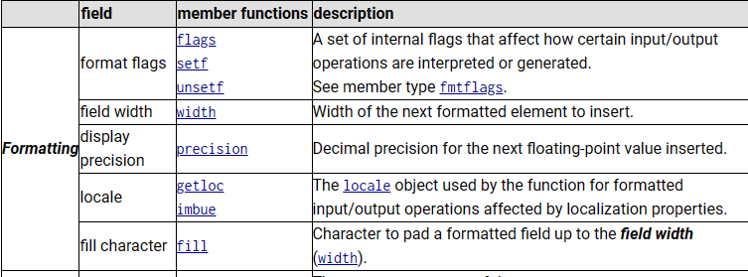
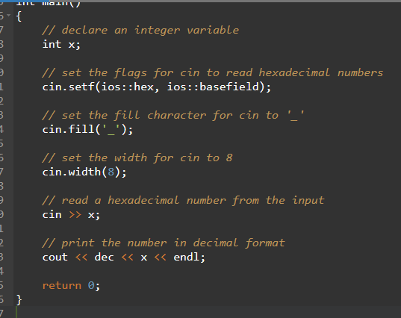
Day1\d1p27.cpp

Slide 62
OOP with C++
An introduction to C++
.
Comments
Single line comment starts with //
Multiple line comments are enclosed between /* and */
Does this work
/*
Outer comment
// Inner comment
*/
Does this work
/*
Outer comment
/* Inner comment */
*/
26/06/2023

Slide 63
OOP with C++
Basic OO concepts
.
Object Oriented (OO) concepts
Class
Objects
Encapsulation
Polymorphism
Inheritance
Abstraction
Composition
26/06/2023

Slide 64
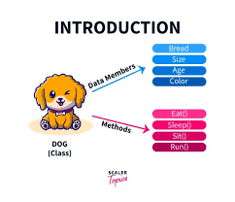
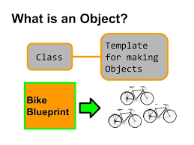
Programming with C++
Basic OO concepts …
.
Class − A class is a data-type that has its own members i.e. data members and member functions. It is the blueprint for an object in object oriented programming language. It is the basic building block of object oriented programming in c++. The members of a class are accessed in programming language by creating an instance of the class.
Some important properties of class are −
Class is a user-defined data-type.
A class contains members like data members and member functions.
Data members are variables of the class.
Member functions are the methods that are used to manipulate data members.
Data members define the properties of the class whereas the member functions define the behaviour of the class.
26/06/2023

Slide 65
Programming with C++
Basic OO concepts …
.
Object
An object is an instance of a class. It is an entity with characteristics and behaviour that are used in the object oriented programming.
An object is the entity that is created to allocate memory.
Inheritance
It is the capability of a class to inherit or derive properties or characteristics of other class. It allows reusability i.e. using a method defined in another class by using inheritance.
Abstraction
Data abstraction or Data Hiding is the concept of hiding data and showing only relevant data to the final user.
26/06/2023

Slide 66
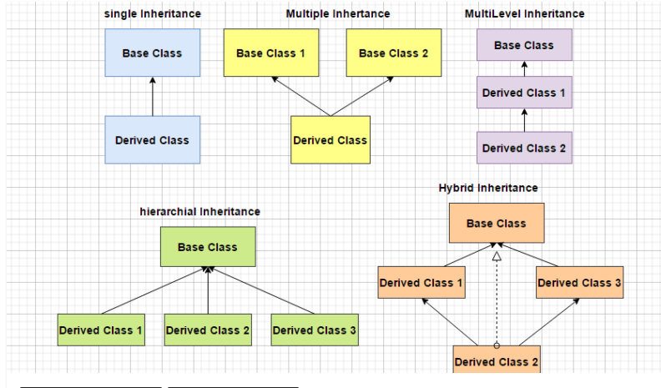
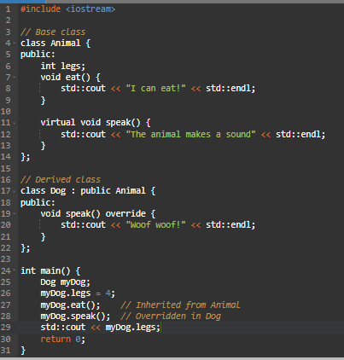

Slide 67
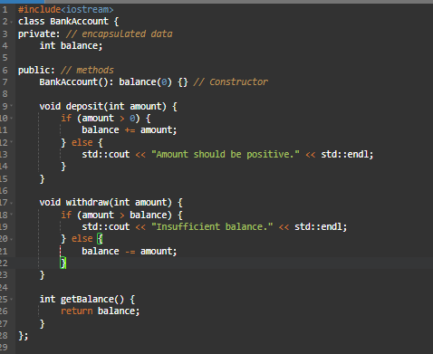
Programming with C++
Basic OO concepts …
.
Encapsulation is the mechanism that binds together code and the data it manipulates, and keeps both safe from outside interference and misuse.
In an object-oriented language, code and data may be combined in such a way that a self-contained "black box" is created.
When code and data are linked together in this fashion, an object is created. In other words, an object is the device that supports encapsulation
26/06/2023

Slide 68
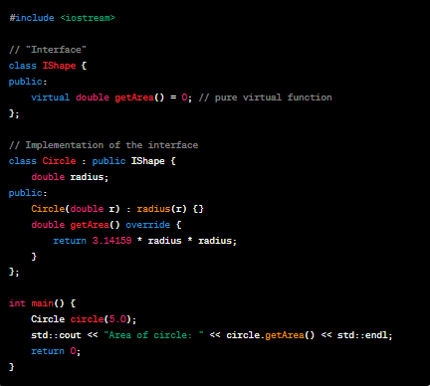
Programming with C++
Basic OO concepts …
.
Abstraction
Data abstraction refers to providing only essential information about the data to the outside world, hiding the background details or implementation.
A real-life example
A man driving a car - The man only knows that pressing the accelerator will increase the speed of the car or applying brakes will stop the car but he does not know how on pressing the accelerator the speed is actually increasing, he does not know about the inner mechanism of the car or the implementation of an accelerator, brakes, etc. in the car. This is what abstraction is.
26/06/2023

Slide 69
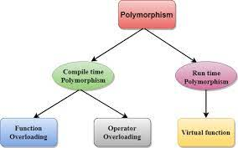
Programming with C++
Basic OO concepts …
.
Polymorphism "one interface, multiple methods." - In simple terms, polymorphism is the attribute that allows one interface to control access to a general class of actions.
2 types of polymorphism – Run time and Compile-time.
A person at the same time can have different characteristics. A man at the same time is a father, a husband, and an employee. So the same person possesses different behavior in different situations. This is called polymorphism. An operation may exhibit different behaviors in different instances. The behavior depends upon the types of data used in the operation.
26/06/2023

Slide 70
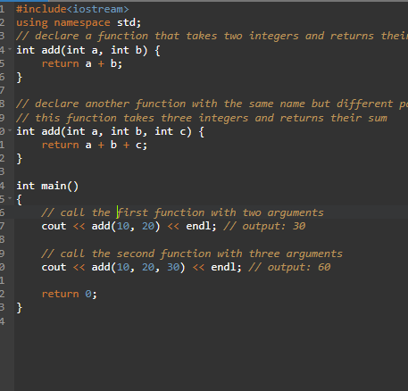
One face many behaviors

Slide 71
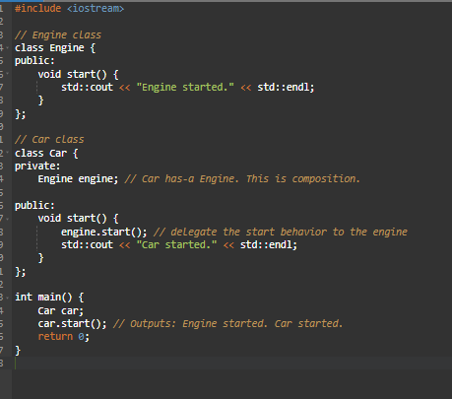
Programming with C++
Basic OO concepts …
.
Composition Composition is the design technique in object-oriented programming to implement has-a relationship between objects.
Composition in C++ is defined as implementing complex objects using simpler or smaller ones. Looking around at our surroundings, we find different things built using several small components. For example, a laptop is constructed using main memory (RAM), secondary memory (Hard Drive), processor, etc.
26/06/2023

Slide 72
Programming with C++
Basic I/O in C++
.
Almost all C++ programs use “cin” and “cout”
“cin” is an object of the input stream and is used to take input from input streams like files, console, etc. ”cout” is an object of the output stream that is used to show output.
Syntax:
Outputting the value of some variable used in the program along with a string
cout << “The value of the variable is: ” << variable;
Take inputs for 2 variables from the keyboard:
cin >> variable1 >> variable2;
Sample program is here.
26/06/2023

Slide 73
Programming with C++
Classes and Objects
.
Class
A class in C++ is the building block that leads to Object-Oriented programming.
It is a user-defined data type, which holds its own data members and member functions, which can be accessed and used by creating an instance of that class.
A C++ class is like a blueprint for an object.
An Object is an instance of a Class. When a class is defined, no memory is allocated but when it is instantiated (i.e. an object is created) memory is allocated.
26/06/2023

Slide 74
Programming with C++
Classes and Objects …
.
Defining a class
class ClassName
{
Access specifier: // private, public or protected
Data members; // Variables to be used
Member functions() { } //Methods to access data members
}; // Class name ends with a semicolon
Creating objects
ClassName ObjectName;
26/06/2023

Slide 75
Programming with C++
Classes and Objects …
.
In C++, there are three access specifiers:
public - members are accessible from outside the class
private - members cannot be accessed (or viewed) from outside the class
protected - members cannot be accessed from outside the class, however, they can be accessed in inherited classes.
By default, class members in C++ are private. Except in struct when they are public
26/06/2023

Slide 76
Programming with C++
Classes and Objects …
.
class MyClass {
public: // Public access specifier
int x; // Public attribute
private: // Private access specifier
int y; // Private attribute
};
int main() {
MyClass myObj;
myObj.x = 25; // Allowed (public)
myObj.y = 50; // Not allowed (private)
return 0;
}
26/06/2023

Slide 77
Programming with C++
Namespaces
.
A namespace is a declarative region that provides a scope to the identifiers (the names of types, functions, variables, etc) inside it. Namespaces are used to organize code into logical groups and to prevent name collisions that can occur especially when your code base includes multiple libraries.
How to define a namespace?
namespace namespace_name
{
// code declarations i.e. variable (int a;)
method (void add();)
classes ( class student{};)
}
there is no semicolon (;) after the closing brace.
To call the namespace-enabled version of either function or variable, prepend the namespace name as follows:
namespace_name: :code; // code could be variable , function or class.
26/06/2023

Slide 78
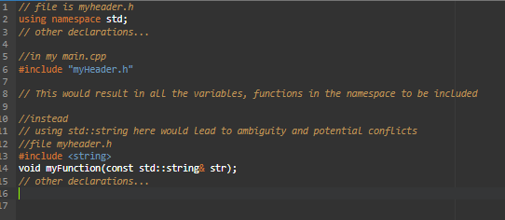
Programming with C++
Namespaces
.
If we use the “using” declaration, we do not need to qualify the names of functions we use from a particular namespace.
Headers Should Not Include using Declarations (??) (a program that didn’t intend to use the specified library name might encounter unexpected name conflicts)
Demo with nameSpace.cpp
One more sample
Namespace pollution
Technically, namespace pollution is simply leaving your symbols in a namespace where they shouldn't really be.
If you don’t declare the identifier in an explicit namespace. the identifier will be in the global namespace.
26/06/2023

Slide 79
Programming with C++
Namespaces
.
Defining Methods Outside the Namespace
We can declare a class inside the namespace block and define it outside of the block. Similarly, we can declare class methods or functions inside and define them outside the namespace block.
Sample program NameSpace2.cpp
Discontiguous Namespaces
We can define namespaces in various program parts that can even be spread over multiple files. This is known as a Discontiguous namespace. The entire namespace is considered as the sum of its separately defined parts.
Sample: NameSpace3.cpp
26/06/2023

Slide 80
Programming with C++
Namespaces
.
We can even have nested namespaces.
Sample: NameSpace4.cpp
Namespace Alias
Sometimes the namespace names can be too long. Hence it becomes hectic to write these long names again and again to access the namespace members, especially when we are using nested namespaces. To avoid this problem, we can use namespace aliases. Aliases are alternate names that we can use instead of the original namespace names. Aliases can be created for both outer (enclosing) and inner namespaces.
Here is the syntax for the namespace alias:
namespace alias_name = namespace_name;
Sample: NameSpace5.cpp
26/06/2023

Slide 81
Programming with C++
Constants in C++
.
We can either use #define or ‘const’ keyword to define constants
Using #define DefineConstant.cpp
Using the ‘const’ keyword – ConstantKeyword.cpp
26/06/2023

Slide 82
Programming with C++
Constants in C++
.
Literals
The value stored in a constant variable is known as a literal. However, constants and literals are often considered synonyms. Literals can be classified on the basis of datatypes.
Types of literals:
Integer literals
Floating-point literals
Characters literals
Strings literals
Boolean literals
User-defined literals
26/06/2023

Slide 83
Programming with C++
Constants in C++
.
Integer Literals - Prefixed
Decimal-literal: Decimal-literals have base 10, which does not contain any prefix for representation. It contains only decimal digits (0,1,2,3,4,5,6,7,8,9). For example, 10,22,34 etc.
Octal-literal: The base of the octal-literals is 8 and uses 0 as prefix for representation. It contains only octal digits (0,1,2,3,4,5,6,7). For example, 010,022,034 etc.
Hex-literal: The base of the Hex-literals is 16 and uses 0x or 0X as the prefix for representation. It contains only hexadecimal digits (0,1,2,3,4,5,6,7,8,9, a or A, b or B, c or C, d or D, e or E, f or F). For example, 0x80,0x16,0x4A etc.
Binary-literal: The base of the Binary-literals is 2 and uses 0b or 0B as the prefix for representation. It contains only binary digits (0,1). For example, 0b11,0b110,0B111
Program: IntegerLiteral.cpp
26/06/2023

Slide 84
Programming with C++
Constants in C++
.
Integer Literals – Suffixed
Type of Integer Literal | Suffixes of Integer Literal
int | No Suffix
unsigned int | u or U
long int | l or L
unsigned long int | ul or UL
long long int | ll or LL
unsigned long long int | ull or ULL
Sample program: IntegerSuffixed.cpp
Program to print the values in HEX, OCT:
DifferentFormats.cpp
26/06/2023

Slide 85
Programming with C++
Constants in C++
.
Floating point literals
Two forms:
Decimal form
Exponential form
Sample program: FPLiteral.cpp
Character Literals
const char VARA = 'A';
String Literals
const string UNIV = “PES University";
Boolean Literals
const bool VARFORTRUE = true;
const bool VARFORFALSE = false;
26/06/2023

Slide 86
Programming with C++
Variables in C++
.
Variables
Variable is basically the name of the memory location that stores data. Every variable has a data type and a value associated with it which we could change any number of times during program execution and a variable can be reused many times in a program.
Basic types of variables in C++
bool, char, wchar_t, nt, float, double, string
Declaring variables
Datatype variable = value;
Single variable, Multiple variables in a single line,
Initializing at the time of declaration, Initializing after declaration
26/06/2023

Slide 87
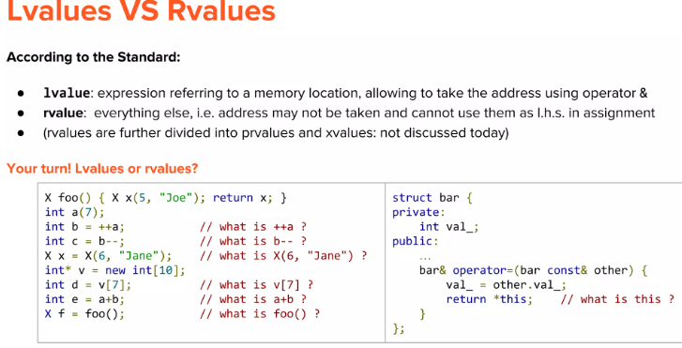
Programming with C++
Variables in C++
.
Lvalues and Rvalues
Every Expression in C++ is either Lvalue or Rvalue expression.
Lvalue: If you can take the address of expression then it is Lvalue. Lvalues represent the objects that occupy space and have some memory location/address associated with them.
Rvalue: If you can't take the address of expression then it is Rvalue. They don't exist after one line or expression and also do not refer to a memory location.
Note: The lvalue can come either on the right-hand side or left-hand side of an assignment statement but the Rvalue can only come on the right-hand side.
26/06/2023

Slide 88
Programming with C++
Variables in C++
.
Examples
1. int x = 10; //x is Lvalue and 10 is Rvalue.
int* ptr = &x; //we can take address of x in ptr because x is Lvalue.
2. int a = 5, b = 15;
int y = a + b;
// y is Lvalue and (a + b) is Rvalue.
int* ptr = &(a+b); //error because (a+b) is Rvalue.
26/06/2023

Slide 89
Programming with C++
Variables in C++
.
Scope of variables
Global
Any variable defined outside all the functions or blocks is a global variable, and it can be accessed by any of the functions. Global variables are self initialized, i.e if a global variable is of int data type, then it is initialized with 0.
26/06/2023

Slide 90
Programming with C++
Variables in C++
.
Types of variables
Local variable
These are the variables defined within a block, function, or method.
They are accessible within that block and get destroyed when the block ends i.e memory assigned to the variable is released.
Initialization of this type of variable is mandatory, if we don't do it, the compiler does it itself and gives it a garbage value.
Sample Code: Scope.cpp
26/06/2023

Slide 91
Programming with C++
Variables in C++
.
Instance variable
These are non-static variables declared in a class outside constructors, methods, and other blocks.
They get memory when the object of that class in which they are declared is created and destroyed when the object is destroyed.
Their initialization is not compulsory while declaring, by default they will have garbage values.
Every object of the class gets a separate copy of their instance variables.
The scope of the instance variable is controlled by the access specifier which is the inbuilt functionality of the class.
Sample code: InstanceVariable.cpp
26/06/2023

Slide 92
Programming with C++
Variables in C++
.
Static variable
These are similar to instance variables but common to every object of the class, in other words, there is only a single copy of static variable per class and static variables are declared with a static keyword.
They get memory at the start of the program and get destroyed when the program ends.
The static variables are stored in the data segment of the memory.
Their initialization is compulsory and it is done outside the class, by default int variable will have 0 value, boolean will have false.
Sample code: StaticVariable.cpp
26/06/2023

Slide 93
Programming with C++
Variables in C++
.
Automatic variables
Variables declared with auto keyword are automatic variables.
Auto keyword specifies that the type of the variable that is being declared will automatically be deduced from its initializer.
The difference between normal and auto variable is that for the normal variable, the user has to specify datatype and with auto keyword, the datatype is automatically deduced by the compiler.
Sample code: AutoVariable.cpp
26/06/2023

Slide 94
Programming with C++
Variables in C++
.
External variable
Variables declared with extern keyword are external variables.
It is used when a particular file needs to access a variable from another file i.e. if there is a variable defined in another file let's say file_1 and we are writing a program in another file i.e. file_2, then we can use the variable defined in file_1 in our file_2 by using extern keyword and including header file of file_1 in file_2.
It is used for variable definition only i.e. variable declared with extern keyword does not get any memory.
int main()
{
// this variable is defined in another file but in this file it is only declared
extern int age;
return 0;
}
26/06/2023

Slide 95
Programming with C++
Functions in C++
.
User-defined functions in C++
A function is a block of code that can be used to perform a specific action. C++ allows programmers to write their own functions, also known as user-defined functions.
A user-defined function has three main components that are function declarations, function definition and function call. Further, functions can be called by call by value or call by reference.
Functions need to be written once and can be called as many times as required inside the program, which increases reusability in code and makes code more readable and easy to test, debug, and maintain the code.
26/06/2023

Slide 96
Programming with C++
Functions in C++
.
Function declaration :
returnType functionName( parameter list );
Function declaration needs to be present before the function is called (invoked)
Function declarations should be in header files.
Function definition
returnType functionName (parameter1, parameter2,...)
{
// function body
}
26/06/2023

Slide 97
Programming with C++
Functions in C++
.
Call by value
Demo with userFunc1.cpp
Call by reference
Demonstrate with SwapValues.cpp
Function overloading
Two or more functions having the same name but different parameters; If we have to perform a single operation with different numbers or types of arguments, we need to overload the function.
Demonstrate with FuncOverload.cpp
26/06/2023

Slide 98
Programming with C++
Functions in C++
.
Rules
Overloaded function can have:
Different number of arguments
Different types of arguments
Different order of arguments
What about this?
int mul(int, int)
double mul(int, int)
This is not a valid form of function overloading (??)
Static polymorphism
Code binding happens at compile time
(Will discuss run-time polymorphism later).
26/06/2023

Slide 99
Programming with C++
Functions in C++
.
Default arguments (parameters)
A default argument is a value provided in a function declaration that is automatically assigned by the compiler if the calling function doesn’t provide a value for the argument. In case any value is passed, the default value is overridden.
Demonstrate with DefaultArgs.cpp
26/06/2023

Slide 100
Programming with C++
Functions in C++
.
Reference parameters
Pass-by-reference means to pass the reference of an argument in the calling function to the corresponding formal parameter of the called function. The called function can modify the value of the argument by using its reference passed in.
Reference parameters are used to pass information in and out of a function .
Demonstrate with ReferenceParams.cpp
int main(int argc, char **argv) { ... }
Variable number of arguments
An ellipsis parameter may appear only as the last element in a parameter list and may take either of two forms: void foo(parm_list, ...); void foo(...);
26/06/2023

Slide 101
Programming with C++
Functions in C++
.
Inline functions
Inline Functions Avoid Function Call Overhead A function specified as inline (usually) is expanded “in line” at each call.
Note The inline specification is only a request to the compiler. The compiler may choose to ignore this request.
Demonstrate using DemoInline.cpp
Each time an inline function is called, the compiler copies the code of the inline function to that call location (avoiding the function call overhead).
26/06/2023

Slide 102
Programming with C++
Functions in C++
.
Lambda functions
C++ Lambda expression allows us to define anonymous function objects (functors) which can either be used inline or passed as an argument.
Lambda expression was introduced in C++11 for creating anonymous functors in a more convenient and concise way.
A basic lambda expression can look something like this:
auto greet = []() {
// lambda function body
};
Here,
[] is called the lambda introducer which denotes the start of the lambda expression
() is called the parameter list which is similar to the () operator of a normal function
26/06/2023

Slide 103
Programming with C++
Functions in C++
.
The above code is equivalent to:
void greet()
{
// function body
}
Now, just like the normal functions, we can simply invoke the lambda expression using:
greet();
Note: The auto keyword has been used to automatically deduce the return type for lambda expression.
26/06/2023

Slide 104
Programming with C++
Functions in C++
.
Demonstrate with Lambda1.cpp
Lambda2.cpp
Lambda3.cpp
26/06/2023

Slide 105
Programming with C++
Functions in C++
.
Template functions
A template is a simple yet very powerful tool in C++. The simple idea is to pass the data type as a parameter so that we don’t need to write the same code for different data types.
C++ adds two new keywords to support templates ‘template’ and ‘type name’ . The second keyword can always be replaced by the keyword ‘class’.
How Do Templates Work?
Templates are expanded at compiler time. This is like macros. The difference is, that the compiler does type-checking before template expansion. The idea is simple, source code contains only function/class, but compiled code may contain multiple copies of the same function/class.
Sample program: FTemplate1.cpp
26/06/2023

Slide 106
Programming with C++
Functions in C++
.
Function Call Resolution
You can have multiple functions with the same name.
You can overload built-in operators like + and ==.
You can write function templates.
Namespaces help you avoid naming conflicts.
More details can be found at:
https://preshing.com/20210315/how-cpp-resolves-a-function-call/
(Will come back to this towards the end of the course)
26/06/2023

Slide 107
Programming with C++
A few abstract data types in C++
.
String and Vector
The string and vector types defined by the library are abstractions of the more primitive built-in array type.
A string is a variable-length sequence of characters.
To use the string type, include the string header. Because it is part of the library, string is defined in the std namespace.
#include <string> using std::string;
string VarName;
26/06/2023

Slide 108
Programming with C++
String in C++
Different ways to initialize a string:
string s1;
Default initialization; s1 is the empty string.
string s2 (s1);
s2 is a copy of s1
string s2 = s1;
Equivalent to s2(s1); s2 is a copy of s1;
string s3 (“value”);
s3 is a copy of the string literal, not including the null
string s3 = “value”;
s3 is a copy of the string literal,
string s4 (n, ‘c’);
Initialize s4 with n copies of the character ‘c’
.
26/06/2023

Slide 109
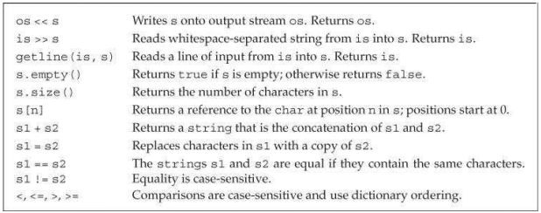
Programming with C++
String in C++
.
Most common string operations
Demonstrate with StringOps.cpp
26/06/2023

Slide 110
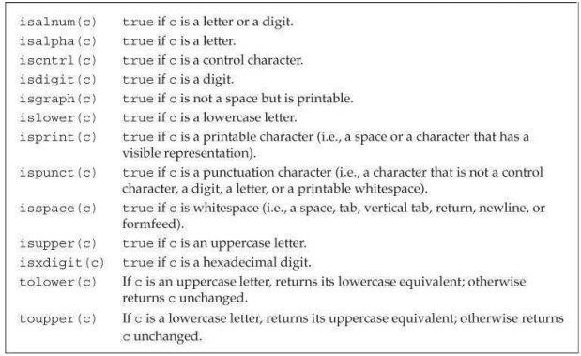
Programming with C++
String in C++
.
Dealing with characters in strings
26/06/2023

Slide 111
Programming with C++
Range-based for
.
Range-Based for
for (declaration : expression) statement
A sample program RangeFor.cpp
26/06/2023

Slide 112
Programming with C++
auto keyword
.
Use of “auto” keyword in C++
Type Inference in C++ (auto and decltype)
auto keyword: The auto keyword specifies that the type of the variable that is being declared will be automatically inferred from its initializer.
In the case of functions, if their return type is auto then that will be evaluated by return type expression at runtime.
Note: The variable declared with auto keyword should be initialized at the time of its declaration or else there will be a compile-time error.
Demonstrate with TestAuto.cpp
26/06/2023

Slide 113
Programming with C++
decltype in C++
The decltype type specifier
The decltype type specifier yields the type of a specified expression.
(The decltype type specifier, together with the auto keyword, is useful primarily to developers who write template libraries. Use auto and decltype to declare a function template whose return type depends on the types of its template arguments)
Demonstrate with Usedecltype.cpp
Note
typeid is an operator in C++. It is used where the dynamic type or runtime type information of an object is needed.
.
26/06/2023

Slide 114
Programming with C++
Vector
.
A vector is a collection of objects, all of which have the same type. Every object in the collection has an associated index, which gives access to that object.
A vector is often referred to as a container because it “contains” other objects.
Note vector is a template, not a type. Types generated from vector must include the element type, for example, vector<int>.
26/06/2023

Slide 115
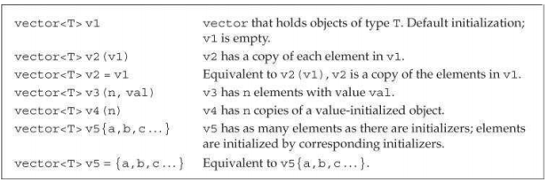
Programming with C++
Vector …
.
Ways to initialize a vector
26/06/2023

Slide 116
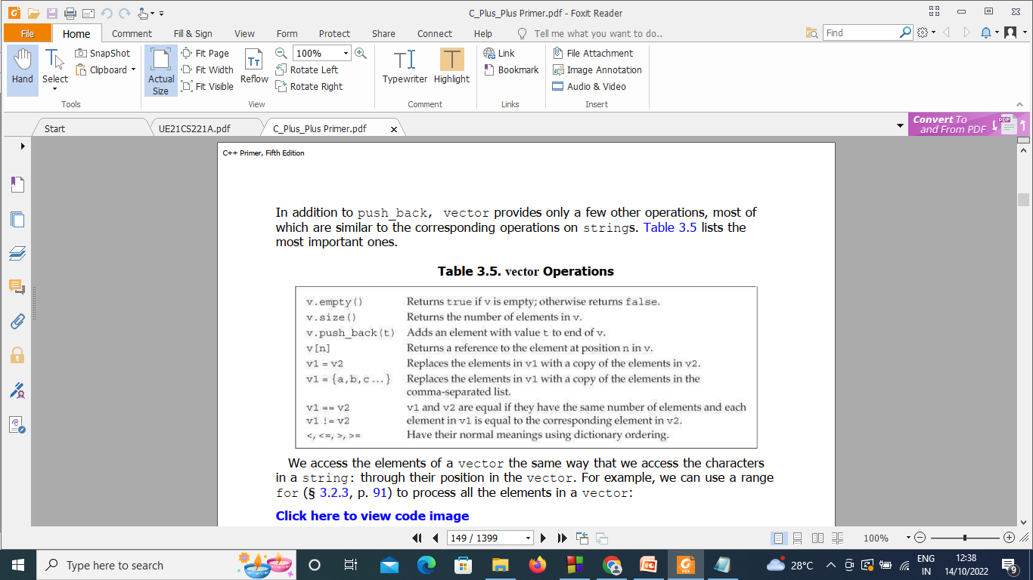
Programming with C++
Vector
.
Vector operations
Demonstration with UseVector.cpp
26/06/2023

Slide 117
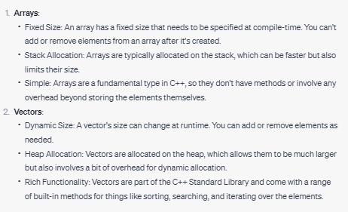

Slide 118
Programming with C++
Arrays
.
Mostly like arrays in C with a few additions.
Two functions to help find the beginning and end of an array.
begin (array name)
end (array name)
begin returns a pointer to the first, and end returns a pointer one past the last element in the given array:
These functions are defined in the iterator header.
26/06/2023

Slide 119
Programming with C++
Templatized Arrays
.
In between arrays and vectors – This is an array wrapped around with an object which gives it more functionalities than the C-type arrays.
Statically allocated
Remembers the size (array) – we can use the size() member function
This is passed by value to a function
Demonstrate with UseBeginEnd.cpp
26/06/2023

Slide 120
Programming with C++
Dynamic memory management
new operator – to allocate memory
new data_type
delete operator – to free (de-allocate)memory
delete pvalue; // Release memory pointed to by pvalue.
The malloc() function from C, still exists in C++, but it is recommended to avoid using malloc() function.
The main advantage of new over malloc() is that new doesn't just allocate memory, it constructs objects which is prime purpose of C++.
Demonstrate with NewDelete.cpp
Another sample program MemArray.cpp
.
26/06/2023

Slide 121
Programming with C++
Dynamic memory management
Note
The “nothrow” object is used in placement new expressions to request that the new operator return a null pointer instead of throwing bad_alloc if the memory allocation request cannot be fulfilled.
A pointer in C++ is a variable that holds the memory address of another variable.
A reference is an alias for an already existing variable. Once a reference is initialized to a variable, it cannot be changed to refer to another variable.
Example: int a = 5; int &ref = a;
.
26/06/2023

Slide 122
Programming with C++
Pointer v/s Reference
.
Pointer | Reference
Not necessary to initialize when declared | Necessary to initialize with a value
Can be assigned a NULL valueq | Cannot be NULL
It must be dereferenced with a * to access the variable’s value. | It does not need to be dereferenced and can be used simply by name.
Arithmetic operations can be performed on it | Arithmetic operations can not be performed on it.
After declaration, it can be re-assigned to any other variable of the same type. | It cannot be re-assigned to any other variable after its initialization.
26/06/2023

Slide 123
Programming with C++
Aliases and typedef
.
You can use an alias declaration to declare a name to use as a synonym for a previously declared type. (This mechanism is also referred to informally as a type alias).
Syntax
using identifier = type;
Remarks
identifier The name of the alias.
type The type identifier you're creating an alias for.
An alias doesn't introduce a new type and can't change the meaning of an existing type name.
26/06/2023

Slide 124
Programming with C++
Aliases and Typedef
.
Typedefs
A typedef declaration introduces a name that, within its scope, becomes a synonym for the type given by the type-declaration portion of the declaration.
typedef unsigned long UL;
alias can be applied to templates whereas typedef can’t.
Here is a sample program: UsingTypedef.cpp
Program using “using” : Using.cpp
26/06/2023

Slide 125
Programming with C++
Garbage Collection
.
What is C++ Garbage Collection?
Garbage collection is a memory management technique. It is a separate automatic memory management method which is used in programming languages where manual memory management is not preferred or done.
In the manual memory management method, the user is required to mention the memory which is in use and which can be deallocated, whereas the garbage collector collects the memory which is occupied by variables or objects which are no more in use in the program.
Only memory will be managed by garbage collectors, other resources such as destructors, user interaction window or files will not be handled by the garbage collector.
26/06/2023

Slide 126
Programming with C++
Garbage Collection
.
What problems can be solved through Garbage Collection?
dangling pointer problem in which the memory pointed is already de-allocated whereas the pointer still remains and points to different reassigned data or already deleted memory
the problem which occurs when we try to delete or deallocate a memory second time which has already been deleted or reallocated to some other object
removes problems or bugs associated with data structures and does the memory and data handling efficiently
memory leaks or memory exhaustion problem can be avoided
26/06/2023

Slide 127
Programming with C++
Garbage collection
.
Disadvantages of Garbage Collector
One major disadvantage of garbage collection is the time involved or CPU cycles involved to find the unused memory and deleting it, even if the user knows which pointer memory can be released and not in use.
Another disadvantage is, we will not know the time when it is deleted nor when the destructor is called.
26/06/2023

Slide 128
Programming with C++
Dangling pointer
.
A dangling pointer is a pointer that points to a deleted (or freed) memory location.
A Pointer can become a dangling pointer in three ways.
1. De-allocation of memory
#include <cstdlib>
#include <iostream>
int main()
{
int* ptr = (int *)malloc(sizeof(int));
// After below free call, ptr becomes a dangling pointer
free(ptr);
// No more a dangling pointer
ptr = NULL;
}
26/06/2023

Slide 129
Programming with C++
Dangling pointer …
.
2. Function call
// The pointer pointing to local variable becomes dangling when local variable is not static.
#include <iostream>
int* fun()
{
// x is local variable and goes out of scope after an execution of fun() is over.
int x = 5;
return &x;
}
int main()
{
int *p = fun();
fflush(stdin);
// p points to something which is not valid anymore
std::cout << *p;
return 0;
}
26/06/2023

Slide 130
Programming with C++
Dangling pointer …
.
3. Variable goes out of scope
int main()
{
int *ptr;
.....
.....
{
int ch;
ptr = &ch;
}
.....
// Here ptr is dangling pointer
}
26/06/2023

Slide 131
THANK YOU
M S Anand
Department of Computer Science Engineering
anandms@yahoo.com

